Slide 1
Recognizing and responding to child poverty in healthcare settings
Emma.sunderland2@nhs.net
Sli.do #childpoverty

Slide 2

Notes:
I want to start with a story which I'm sure is one that will be familiar to many of you.
Its 3am I'm in a DGH and you get a blue light call. Its an 11 year old with asthma and there is one child that comes to mind, discharged only a week or two ago. As he's wheeled through the door I instantly recognize his mother and she looks terrified. He arrives with a silent chest and is agitated, unable to keep the nebuliser on his face, his gas shows a respiratory acidosis, his CO2 is 9. I'm there with another registrar and friend who also knows Nathanial well and together we spend the night throwing every possible treatment at him until eventually he starts to turn the corner just as handover approaches. This is not the first time this is happens and its not the last. On one occasion Nathanial is brought in, not in extremis but his mother is (rightly) worried that he could soon deteriorate. I take the history as usual hunting for possible triggers as its again only a week since he's been discharged, take the opportunity to find out how things are going at home and school after so many hospital admissions. Nathanial says "I don’t know if I should tell you this...but we had to move and we're living with other people and I think their cooking is setting off my asthma". I ask some more questions and discover that Nathanial's mother has lost her job where she worked in a bar as she missed too many shifts while Nathanial was in hospital and they have lost their home. They are living in a hostel on a busy, polluted road. Now Nathanial comes into hospital every week, he becomes more and more anxious, his older siblings have to stay with him on the ward as his mum tries to find other work. He misses school and stops playing football. He's seen by the tertiary specialists, his diagnosis is reviewed, he is extensively investigated and every aspect of his asthma care is optimized, yet still he keeps coming in.

Slide 3

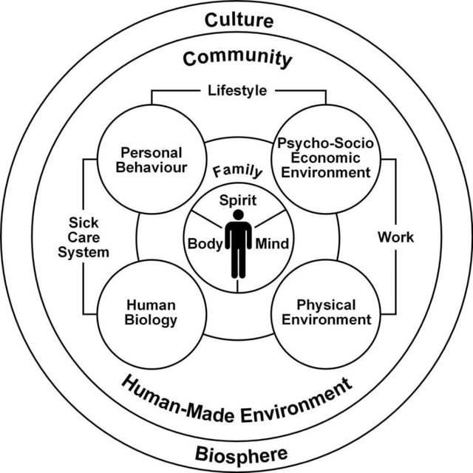

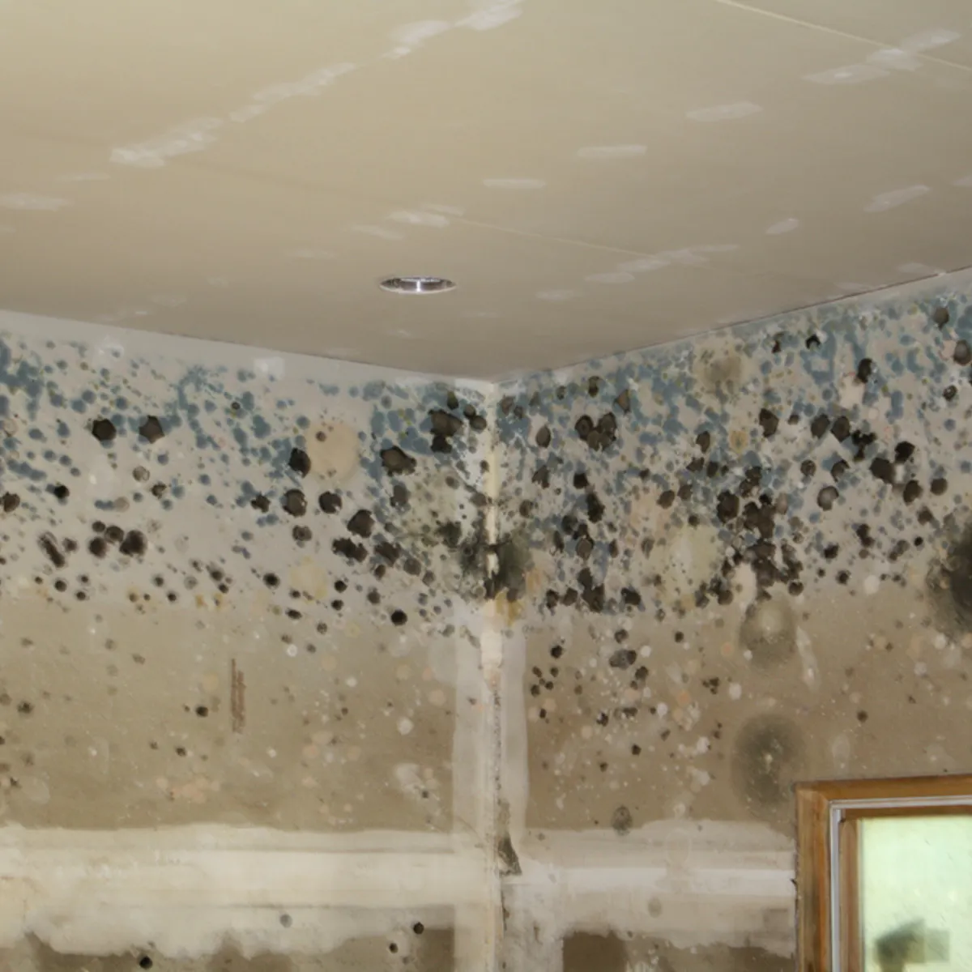
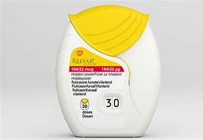
"Why treat people and send them back to the conditions that make them sick?"
Notes:
Asthma is one of many conditions that has a strong association with poverty.
Buelo A, McLean S, Julious S the ARC Group, et al At-risk children with asthma (ARC): a systematic review Thorax 2018;73:813-824.
Poverty/obesity/vitamin D deficiency/low parental education/african-american all 'risk factors' poorly controlled asthma.

Slide 4
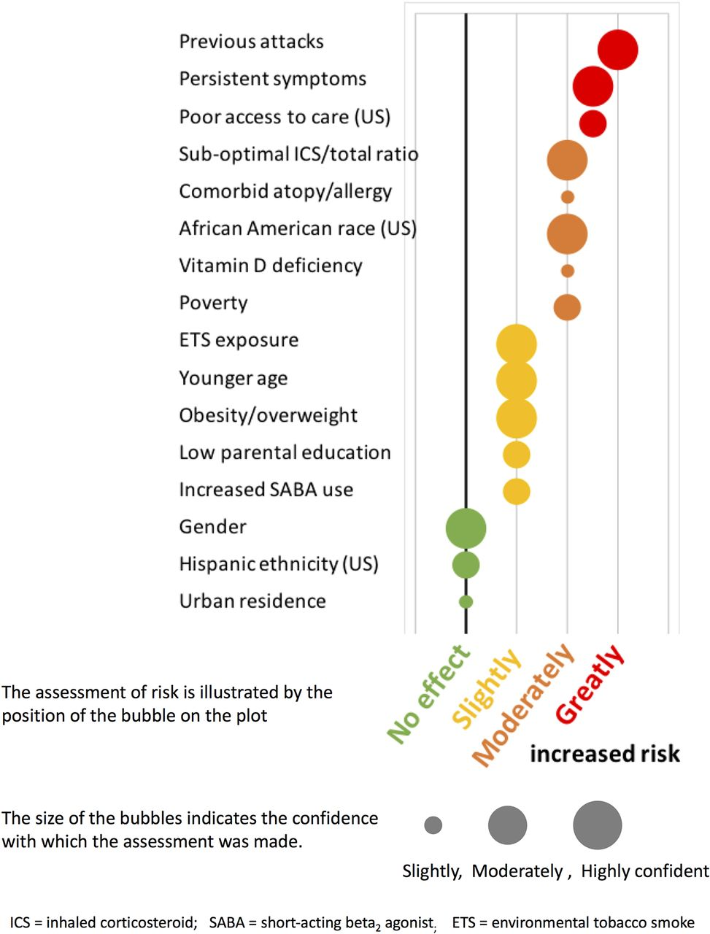
Notes:
Buelo A, McLean S, Julious S the ARC Group, et al At-risk children with asthma (ARC): a systematic review Thorax 2018;73:813-824.
Poverty/obesity/vitamin D deficiency/low parental education/african-american all 'risk factors' poorly controlled asthma.

Slide 5
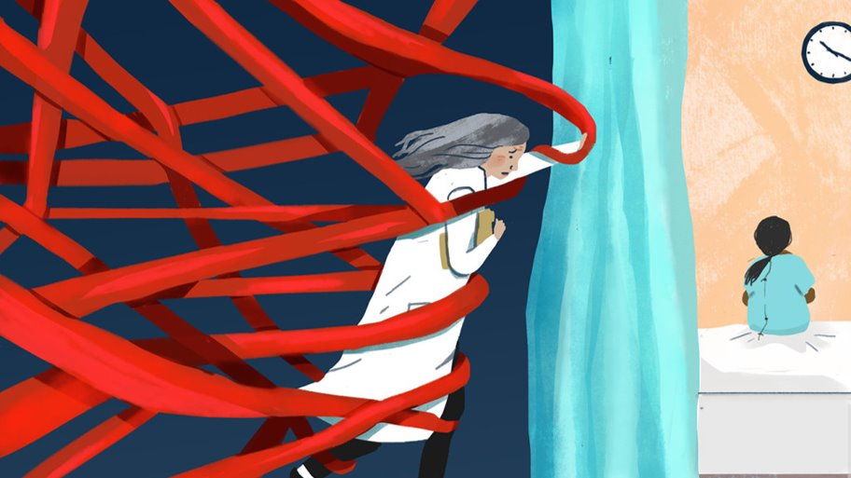
Notes:
What did I do? I reassured Nathanial, I told their consultant, wondered whether we should write a letter to support housing applications but really didn't have any other ideas. Ultimately I felt powerless.

Slide 6
Sli.do #childpoverty
Notes:
I'm sure every one of you has faced a similar situation...what results is moral injury and burnout.

Slide 7
Outcomes for the session
To reflect upon the relationship between poverty and common childhood diseases.
To consider the wider context of poverty locally, nationally and in the context of the pandemic.
To start to recognize poverty in those presenting to healthcare settings.
To have the tools to be able to respond to poverty at an individual level.
To shape the development of tools that will help you to do this.

Slide 8
Measures of poverty
World bank and UN
  Not able to avoid the basics of life (food, clothing, shelter)
Households Below Average Income (HBAI) Department for Work and Pensions
  Poverty line = 60% of median UK household income.
  Relative poverty “living in poverty” = less than 60% of median income (£17820)
  Absolute poverty = <60% of 2011 median (adjusted for inflation)

Slide 9
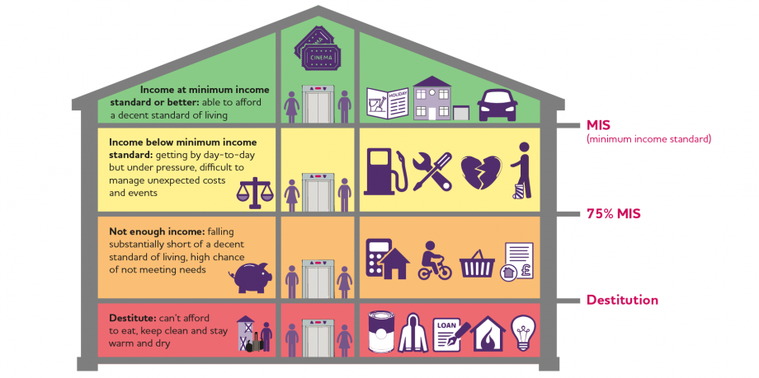
Minimum Income Standard (MIS)
Single person needs to earn £19,200/yr. Couple with 2 children each need to earn £18,700/yr
Notes:
2020 Report identified what families need now to meet material needs and participate in society – Joseph Rowntree Foundation
For children being able to go on their school trip.
Material deprivation index for child poverty

Slide 10
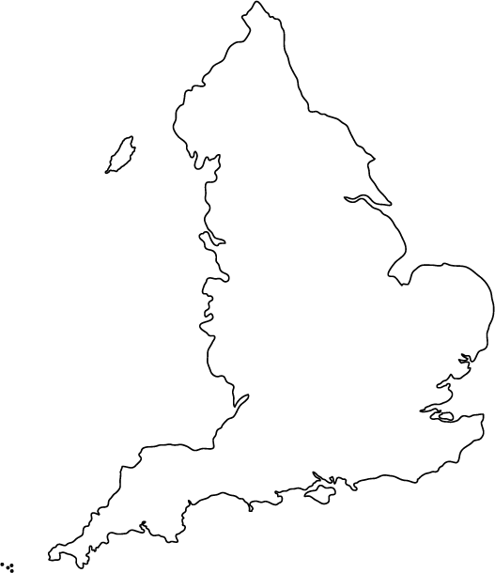
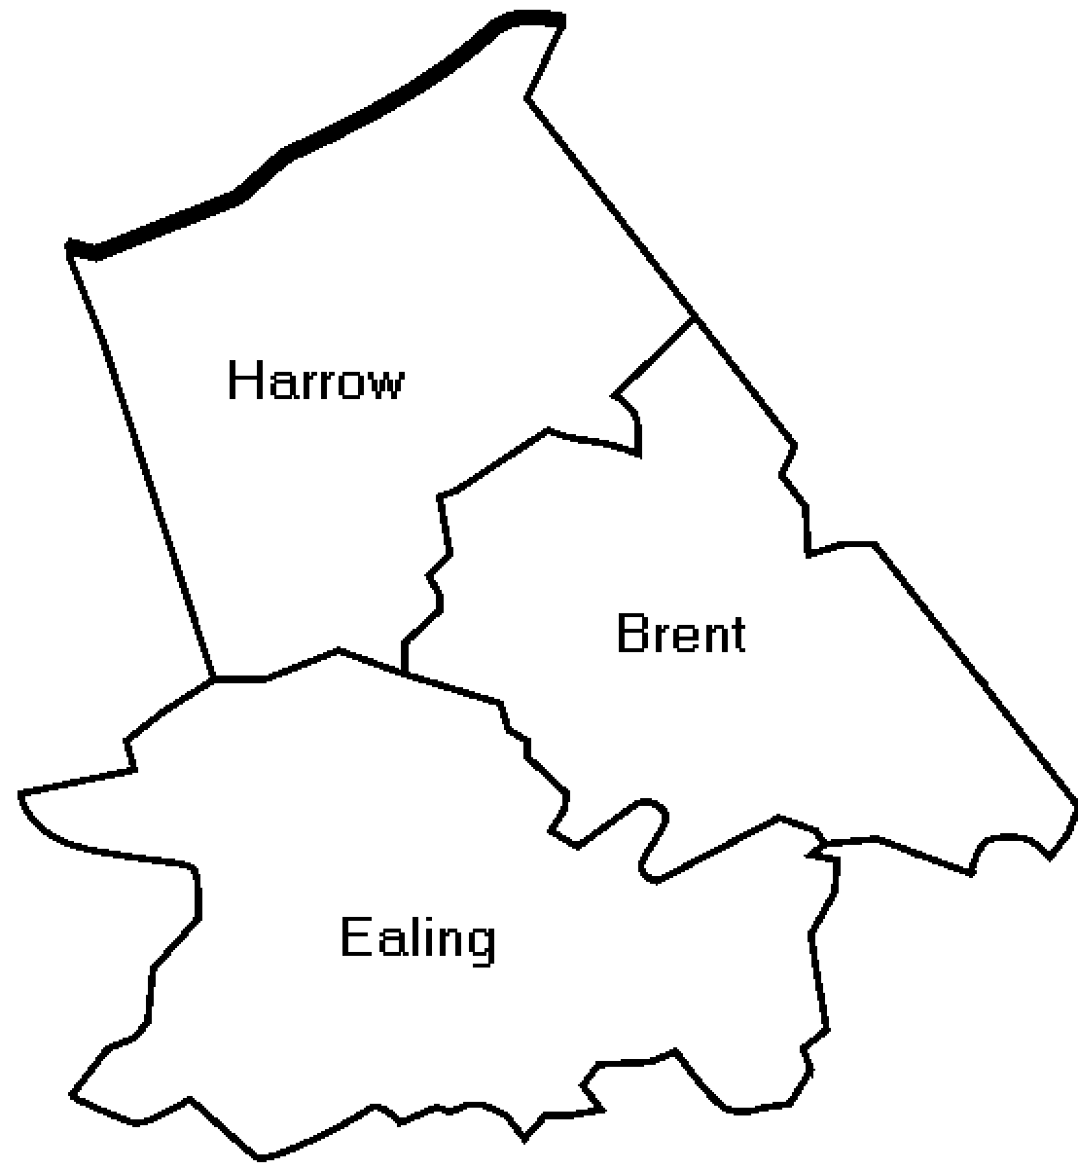
National/Local picture & Health outcomes
Children in low-income families : % children in low-income families (children living in families in receipt of out of work benefits or tax credits where reported income <60% median income) for <16 years only - PHE Fingerprints
4.1 million children in the UK live in poverty
9 children in every classroom of 30
12%
17%
18%
16.9%
Notes:
34% children nationally – material deprivation
37% children in Brent
13% of children living in households <40% median income

Slide 11
Causes of child poverty
Triggers:
LIFE EVENTS/ TRANSITION
Unemployment
Low wages
High costs
Ineffective benefits
Ill health/disability
Discrimination
CAUSES
CONSEQUENCES
HEALTH OUTCOMES

Slide 12
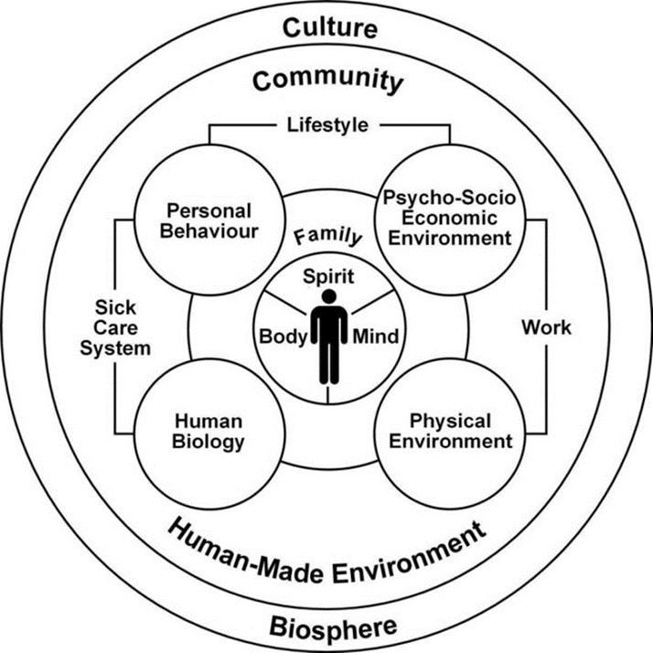
Consequences of child poverty
Children living in poverty in the UK are more likely to:
  die in the first year of life
  be born small
  be bottle fed
  breathe secondhand smoke
  become overweight
  suffer from asthma
  have tooth decay
  perform poorly at school
  die in an accident

Slide 13
Sli.do #childpoverty
Notes:
Quiz – Marmot 10 years on

Slide 14
COVID19
Unemployment, under employment
  1.5 million more claiming work-related benefits since March
  1 in 3 parents have seen their income reduced
Food insecurity
  5.5% UK cannot afford meal with meat, fish, veg equivalent/2nd day
  Acute food insecurity expected to double to 265 million worldwide
Household environments
  10.2% EU not heated adequately
  1 in 10 UK do not have internet access
Health
  Fears in seeking care
  Limitations on service provision
Toxic stress
  Negative parenting practices increased
  YP 2.5 times more likely to be affected by mental ill health if parents struggling to make ends meet
School
  Est. 138 countries closed schools nationwide
  5% EU no suitable place to do homework
  Increase in home schooling
Unemployment, under employment
Low pay
Ineffective benefits
High cost of living
Disability
Discrimination
Covid-19
Lockdown
Notes:
unemployment and low-paid jobs lacking prospects and security (or a lack of jobs): too many jobs do not provide decent pay, prospects or security. Many places have concentrations of these jobs or do not have enough jobs. Low pay and unemployment can also lead to inadequate savings or pensions
low levels of skills or education: young people and adults without the necessary skills and qualifications can find it difficult to get a job, especially one with security, prospects and decent pay
an ineffective benefit system: the level of welfare benefits for some people – either in work, seeking work or unable to work because of health or care issues – is not enough to avoid poverty, when combined with other resources and high costs. The benefit system is often confusing and hard to engage with, causing errors and delays. The system can also make it risky and difficult for some to move into jobs or increase their working hours. Low take-up of some benefits also increases poverty
high costs: the high cost of housing and essential goods and services (e.g. credit, gas, electricity, water, Council Tax, telephone or broadband) creates poverty. Some groups face particularly high costs related to where they live, increased needs (for example, personal care for disabled people) or because they are paying a ‘poverty premium’ – where people in poverty pay more for the same goods and services
discrimination: discrimination against people because of their class, gender, ethnicity, disability, age, sexuality, religion or parental status (or even poverty itself) can prevent people from escaping poverty through good qualifications or jobs, and can restrict access to services
weak relationships: a child who does not receive warm and supportive parenting can be at higher risk of poverty in later life, because of the impact on their development, education and social and emotional skills. Family relationships breaking down can also lead to poverty
abuse, trauma or chaotic lives: for small numbers of people, problematic or chaotic use of drugs and alcohol can deepen and prolong poverty. Neglect or abuse as a child or trauma in adult life can also cause poverty, as the impact on mental health can lead to unemployment, low earnings and links to homelessness and substance misuse. Being in prison and having a criminal record can also deepen poverty, by making it harder to get a job and weakening relationships.
Covid-19
Lockdown
Policymakers have targeted the most vulnerable as those with multiple medical comorbidities ignoring social factors

Slide 15
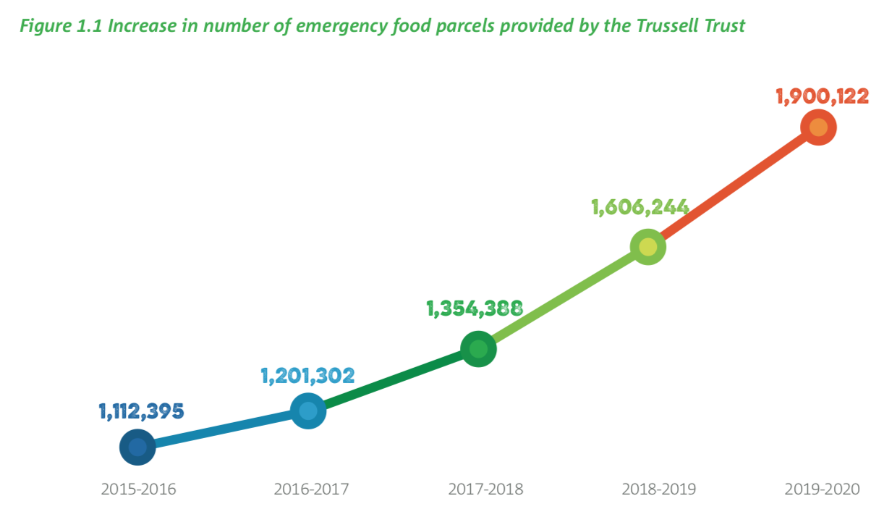
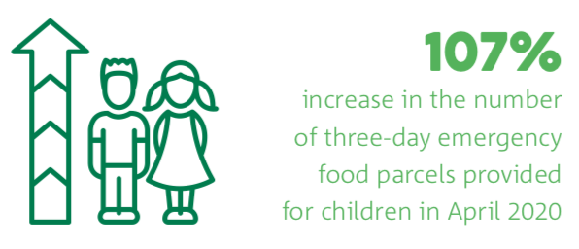
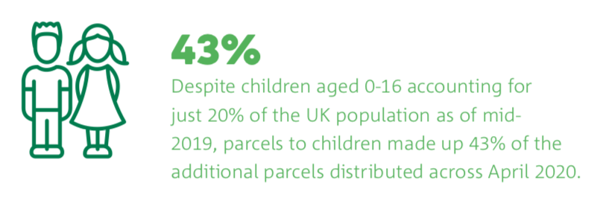
Food bank use
Notes:
Trussel Trust
Significant increase of food bank support for first time
Families with children hit the hardest (used to be 1 in 3, now 4 in10)
Only 4% furloughed persons using food banks, success of scheme?
2 in 3 are 22-44 years, 53% increase that early 2020
72% of households using foodbank experience poor mental health

Slide 16

How could it help me to know that Nathanial’s family are having financial difficulties?

Slide 17
How can we recognize child poverty in healthcare settings?
Building on family and social history
HEADS for poverty
Key questions
Self-identification

Slide 18
Building on family and social history
FHx
Parent or sibling in poor health
More than 3 children
SHx
Single parent
Parental employment
Social worker
Notes:
What do you already ask that could give you some clues that a family may be in need of more support?
Ill health and disability make it more likely that a family will experience poverty (about 30% of those living in poverty have a disability)
2 child limit on UC benefits claimants, loosing over £2000/year 43% children in larger families living in poverty
1 in 3 parents have seen their income decrease during covid
72% of children living in poverty are from working families
Social worker -> adverse childhood experiences are much more common in the most deprived decile these include parental separation, abuse, domestic violence, substance missuse, all reasons a child may have a social worker. Increasing evidence about the impact of this on health throughout the life course.

Slide 19
BOX 5: The adapted “HEADSS” tool for poverty
Questions | Red flags and cues for poverty
Home: Who lives at home with you? What is your house like? | Chronic physical or mental health problems, >3 young children, single parent Housing concerns: pests, leaks, mould, cold, overcrowding
Employment/Education Do you work? What is your job? How is your child doing at school? | -Unemployment/low income, asylum seekers, travellers. -Developmental delay, poor school attainment, poor attendance
Activities: Do you have any hobbies? Have you been on holiday in the last year? | -Lack of disposable income for hobbies, holidays or transport -Social isolation
Diet: What did you eat yesterday? In the last year, have you worried that your food would run out before you got money to buy more? | -Lack of (healthy) food, unable to afford fresh fruit and vegetables -Parents missing meals to feed children -Free school meals -Foodbank use
Safeguarding/Support Have you ever had a social worker? Has anyone ever hurt or threatened you? | -Reasons for social worker could give insight into current and previous vulnerabilities. Consider what support they already have? Are they receiving benefits? -Physical, emotional, sexual abuse or neglect warrants further investigation and referral as per local pathways.
Notes:
Guys and St Thomas': ED clerking booklet

Slide 20
Key questions
The following questions are asked to all parents at registration in ED:
Do you have difficulty making ends meet at the end of the month?
Do you receive milk vouchers, free school meals or free prescriptions?
Do you worry that your housing is affecting your child's health?
Notes:
Q1 98% sensitivity and 60% specificity Development of a Tool to Identify Poverty in a Family Practice Setting: A Pilot Study. BRcic 2011. IJFM (Canadian study)
Screening for Poverty and Poverty-Related Social Determinants of Health
Rachel Stein Berman, Milani R. Patel, Peter F. Belamarich and Rachel S. Gross
Pediatrics in Review May 2018, 39 (5) 235-246; DOI: https://doi.org/10.1542/pir.2017-0123

Slide 21
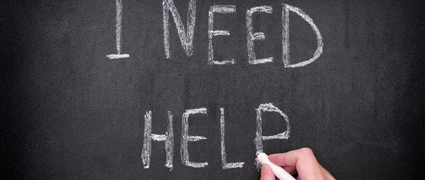
Self-identification

Slide 22
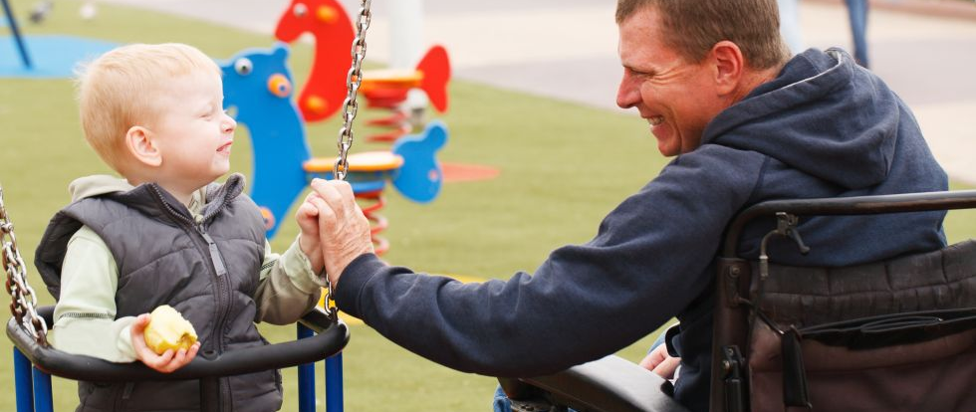
What would parents prefer?
Notes:
Research from outside of the UK generally indicates that parents are ok with being asked these questions. Colleagues have highlighted that where they have identified an area in which a family is struggling that they have expressed relief that the doctor had brought it up and was able to direct them to help. This is a gap in the research base and an area that can and should be explored locally.

Slide 23
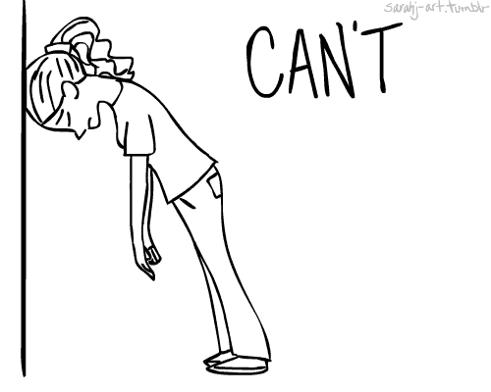
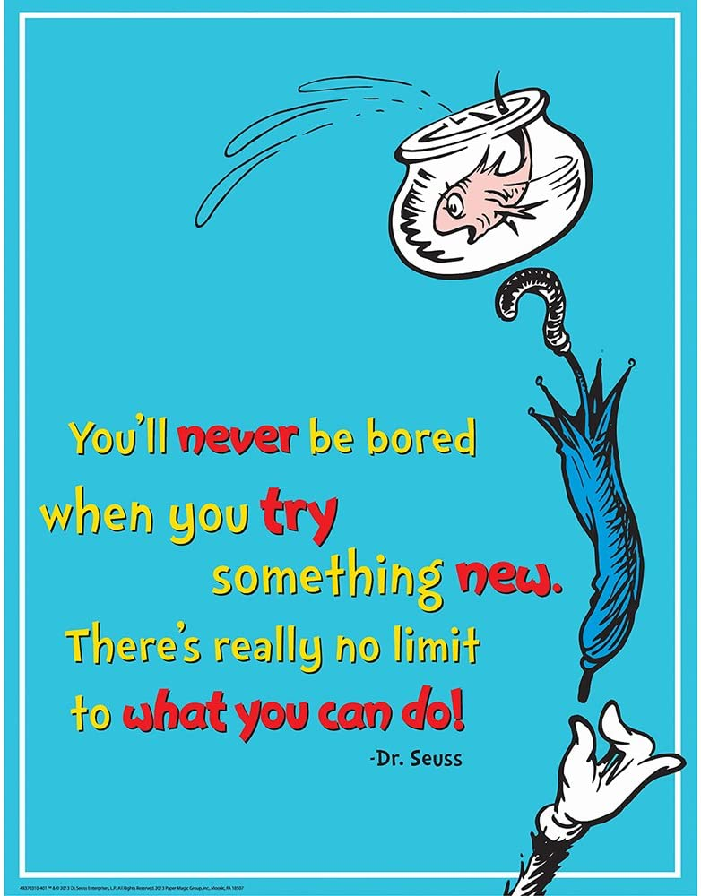
My job is to treat Nathanial’s asthma…its not working

Slide 24
Responding to poverty in healthcare settings
Emergency relief
1,2,3 fight inequality leaflet
Linking with social prescribers in primary care
Special considerations for migrant families

Slide 25

Emergency relief

Slide 26
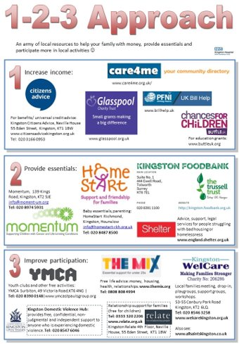
1,2,3 fight inequality

Slide 27

Social prescribing
Notes:
Increasing emphasis on "social prescribing" across London
-Good coverage across Brent (Harrow to be confirmed)
-GP practices have community navigators that can help patients with benefits, signpost them to community organizations and wellbeing activities.
-Evaluation elsewhere suggests that this approach is cost effective

Slide 28
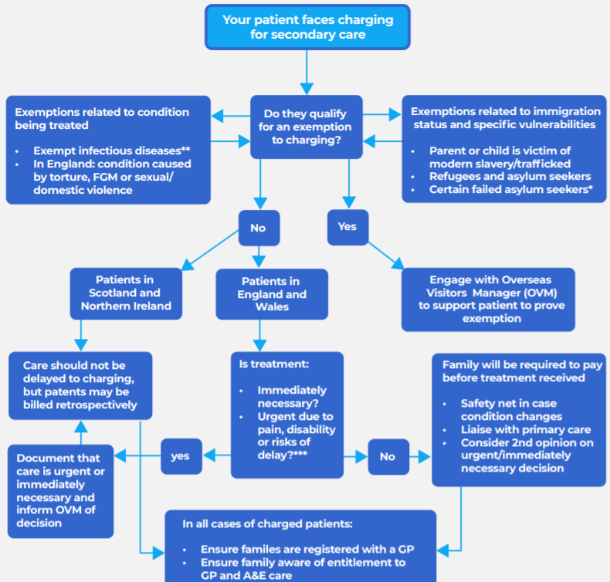
Special considerations for migrant families
RCPCH Guidance: Rights to access healthcare November 2020
List of organizations that can support families with no recourse to public funds, offer legal services and more.

Slide 29

What else can I do?
Adding our voices to campaigns led by others
National and Local Advocacy
Join 4 in 10 and/or CPAG
Join the NWP project team!

Slide 30
Advocacy at a local level
Experiences within healthcare
?
Actions that address the route causes of poverty
Linking with
Commisioners
Social care
Third sector organisations
Local councillor or MP
Public health board

Slide 31
Questions + comments
Survey to complete
Email with useful links and recommended articles

Slide 32
Outcomes for the session
To understand the relationship between poverty and common childhood diseases.
To consider the wider context of poverty locally, nationally and in the context of the pandemic.
To start to recognize poverty in those presenting to healthcare settings.
To have the tools to be able to respond to poverty at an individual level.
To shape the development of tools that will help you to do this.

Slide 33


